Slide 1
LECTURE 3
Building and Using Actor Classes

Slide 2
LECTURE GOALS AND OUTCOMES
The goals of this lecture are to
Show how to add components to a Blueprint
Introduce the Construction Script
Present various types of events
Demonstrate how to spawn, destroy, and reference Actor instances
Show how to do input mappings
By the end of this lecture you will be able to
Add various types of components to a Blueprint
Manage Actor instances
Create collision and mouse events
Create input events and map keys and axes

Slide 3
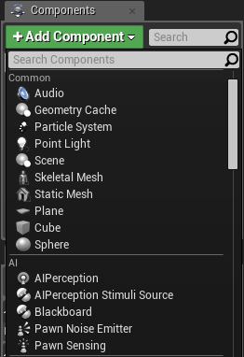
COMPONENTS
Components are ready-to-use classes that can be used inside Blueprints. Several features can be included in a Blueprint using only components.
To add components to a Blueprint, use the Components panel in the Blueprint Editor.
The image on the right shows the Components panel for a new Blueprint with some component options that are displayed when the Add Component button is pressed.

Slide 4
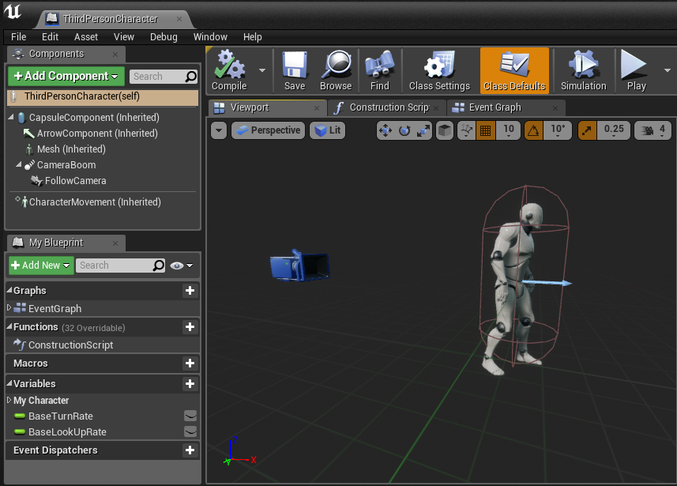
COMPONENTS: VIEWPORT
The visual representation of the components can be seen in the Viewport.
The image on the right shows the components that are part of the ThirdPersonCharacter Blueprint from the Third Person template. The components that have “(Inherited)” next to the name were inherited from the Character class.
The CapsuleComponent is used for collision testing.
The Mesh component is the Skeletal Mesh that visually represents the character.
The FollowCamera component is the camera that will be used to view the game.
The CharacterMovement component contains various properties that are used to define the movement.

Slide 5
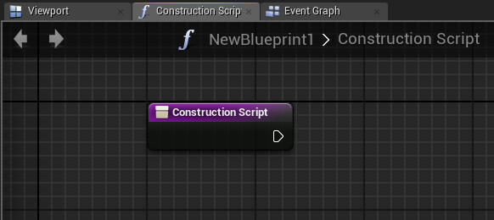
CONSTRUCTION SCRIPT
The Construction Script is a special function that all Actor Blueprints perform when:
The Blueprint is first added to the Level
There is a change to its properties
The class is spawned at runtime.
The Construction Script has a separate graph where the actions to be performed can be placed.
It is important to note that the Construction Script won’t run on placed Actors when the game starts.

Slide 6
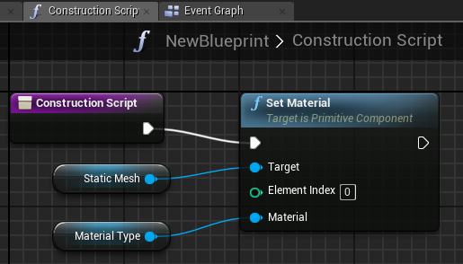
CONSTRUCTION SCRIPT: EXAMPLE
The Construction Script seen on the right uses the Set Material function to define a Static Mesh component’s Material type according to the Material selected in the editable variable Material Type.
Whenever the Material Type variable is modified, the Construction Script runs again, updating the object with the new Material.

Slide 7

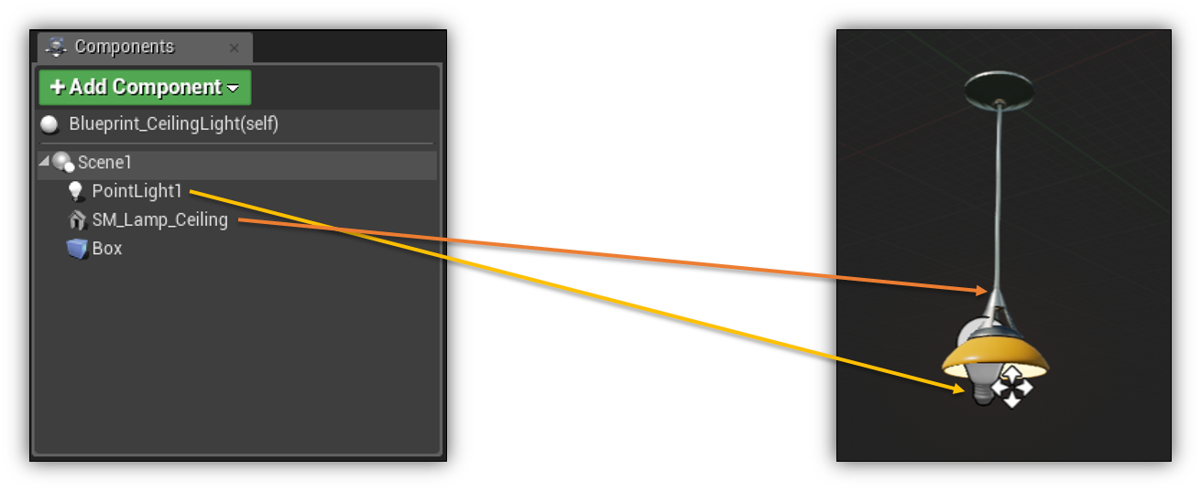

BASIC FUNCTIONALITY: COMPONENTS
A Blueprint can be made up of multiple components, each adding functionality to a single final asset.
This Blueprint includes four components:
A scene component that acts as a root location from which everything else is placed
A static mesh component that represents the 3D model of the light
A point light component to emit light into the scene
A box collision component to detect when a player is standing under or near the light
Identifying components

Slide 8
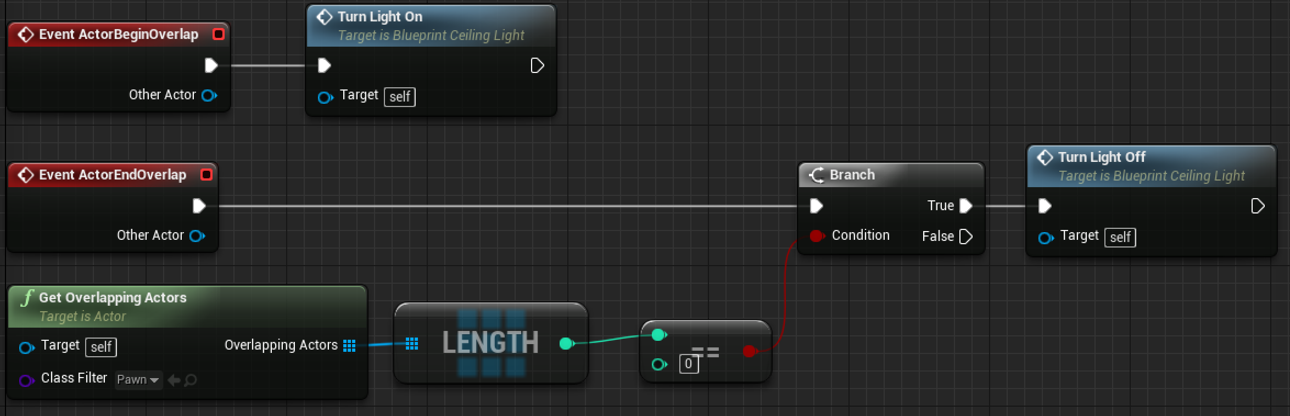
BASIC FUNCTIONALITY: EVENTS
The Blueprint has two default events associated with Actors:
ActorBeginOverlap calls the event to turn the light on from the previous slide.
ActorBeginEndOverlap checks if there are any players nearby and, if not, calls the event to turn the light off.
An example of using Events to
toggle a light

Slide 9
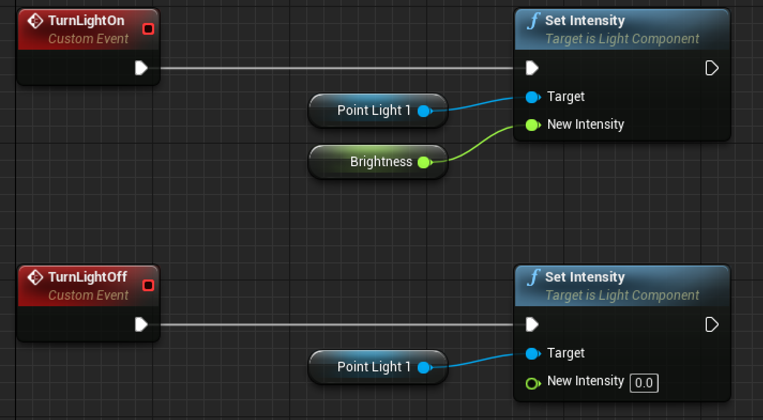
BASIC FUNCTIONALITY: CUSTOM EVENTS
The Blueprint has two custom events:
TurnLightOn sets the light intensity to a value set in the Brightness variable.
TurnLightOff sets the light intensity to 0.
Custom Event examples

Slide 10
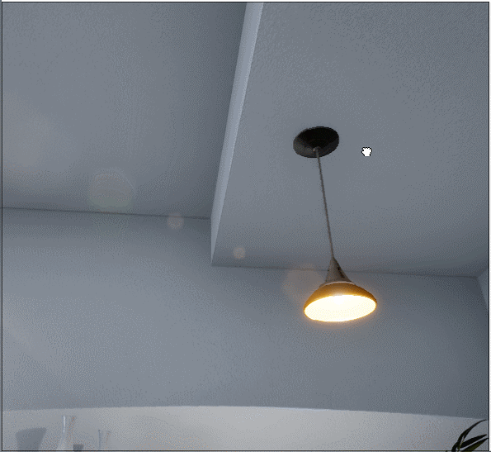
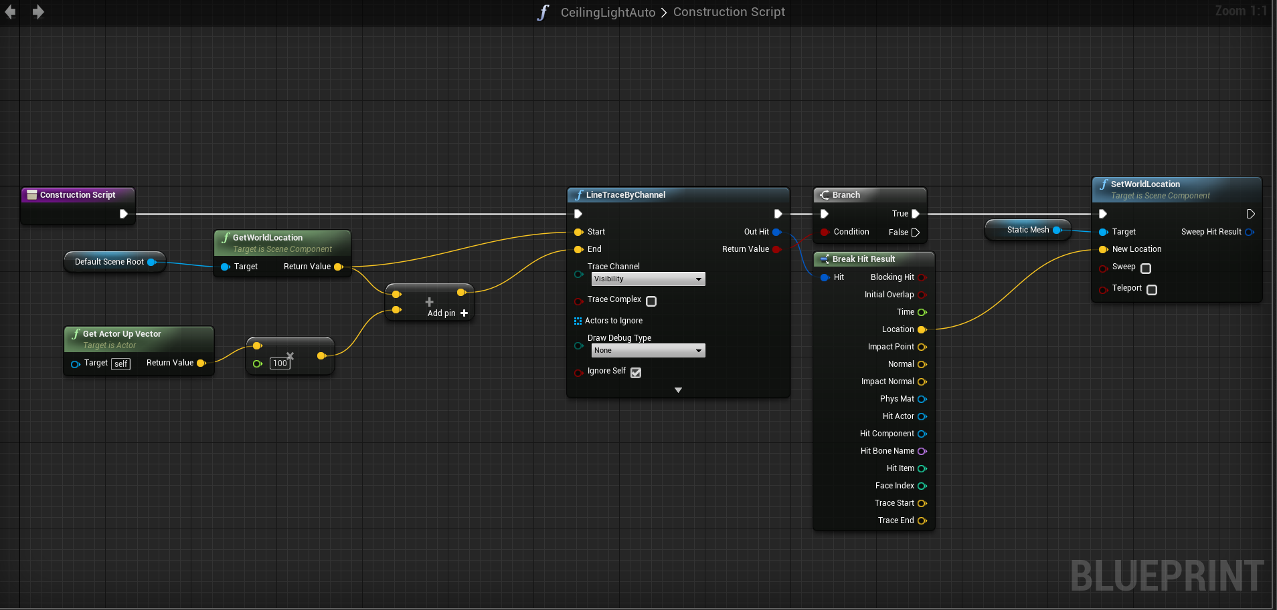
BASIC FUNCTIONALITY:
LIGHT PLACEMENT EXAMPLE
In this example, the Construction Script is being used to automatically place the light on the surface of the roof. If there is a surface within 1m above the actor it will automatically move the light mesh to snap to the surface.
When the Construction Script is run, this light traces upward to see if there’s a surface. If there is, it moves the ceiling light mesh to that surface for realistic auto-placement.
The Construction Script in action

Slide 11
EVENTS

Slide 12
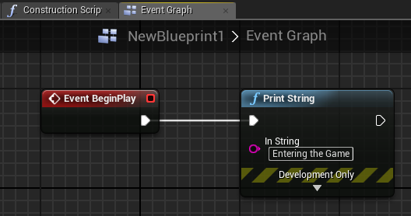
BEGIN PLAY EVENT
Events allow communication between Unreal Engine and Actors. A common example is the BeginPlay event.
The BeginPlay event is triggered when the game starts for an Actor. If the Actor is spawned in the middle of the game, then this event is triggered immediately.

Slide 13
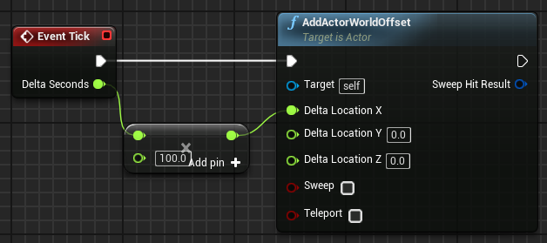
TICK EVENT
There is an event named “Tick” that is called every frame of the game. For example, in a game that is running at 60 frames per second, the Tick event is called 60 times in a second.
The Tick event has a parameter known as Delta Seconds, which contains the amount of time that has elapsed since the last frame.
In the Tick event illustrated on the right, an Actor moves along the X axis at the speed of 100 centimeters per second.
Use the Tick event only when necessary, as it can affect performance.

Slide 14
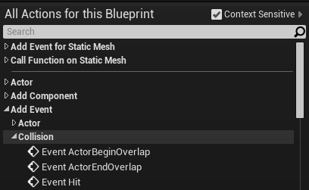
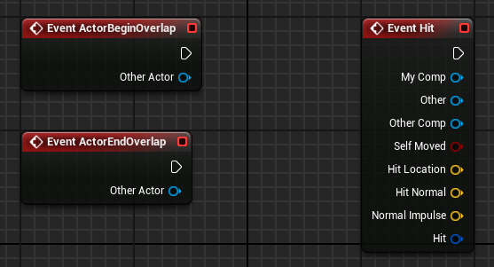
COLLISION EVENTS
Collision events are triggered when two Actors collide or overlap.
Event ActorBeginOverlap will execute when two Actors start overlapping and the Generate Overlap Events property of both Actors is set to “true”.
Event ActorEndOverlap will execute when two Actors stop overlapping.
Event Hit will execute if the Simulation Generates Hit Events property of one of the Actors in the collision is set to “true”.

Slide 15
ACTOR INSTANCES

Slide 16
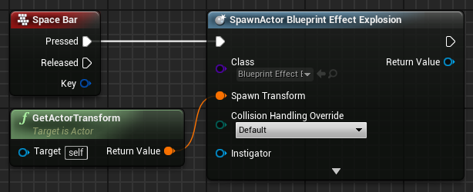
SPAWNING ACTORS
Spawn Actor from Class is a function that creates an Actor instance using the class and transform specified.
The Collision Handling Override input defines how to handle the collision at the time of creation. The output parameter Return Value is a reference to the newly created instance.
In the example on the right, when the space bar is pressed, an instance of the Blueprint Effect Explosion class is created at the same location (transform) of the current Blueprint.

Slide 17
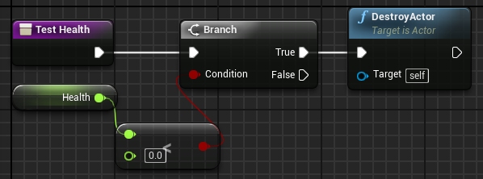
DESTROYING ACTORS
The DestroyActor function removes an Actor instance from the Level at runtime. The instance to be removed must be specified in the Target parameter.
The image on the right shows a function named “Test Health” that will check if the value of the Health variable is less than zero. If “true”, the current instance of this Blueprint, which is represented by “self”, will be destroyed.

Slide 18
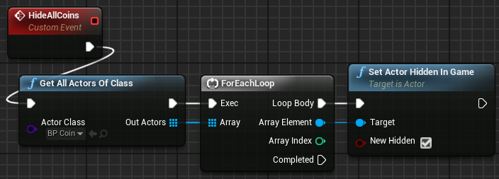
GET ALL ACTORS OF CLASS
Get All Actors Of Class is a function that gets the references of all the Actors in the current Level who belong to a specified class.
The Actor Class parameter specifies the class that will be used in the search.
The Out Actors output parameter is an array containing references to the Actor instances of the specified class found in the Level.
In the image on the right, Get All Actors Of Class returns an array of BP_Coin Actors, then uses a ForEachLoop node to set the New Hidden property to “true” in the Set Actor Hidden In Game function for each Actor in the array.
This can be a costly operation. Do not use it in the Tick event.

Slide 19
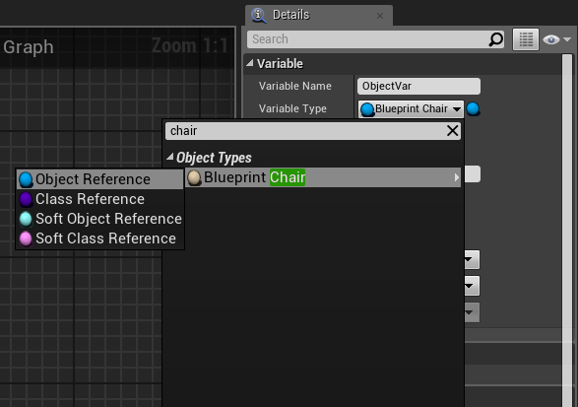
REFERENCING ACTORS
In a Blueprint, it is possible to create a variable that references an Object / Actor.
The example on the right shows the creation of a variable that references an instance of the Blueprint_Chair class. An Object Reference points to an Actor that is in the Level.
When created, the variable is empty. A way to set an instance to this variable is to check the Instance Editable property, add the Blueprint to the Level, and in the Details panel select an Actor that is in the Level.
Another way is to use the return value of the Spawn Actor from Class function.

Slide 20
PLAYER INPUT

Slide 21
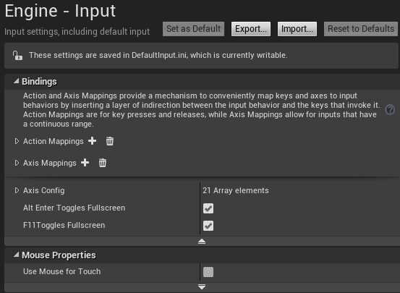
INPUT MAPPINGS
It is possible to create new input events that represent actions that make sense in the game.
For example, instead of creating an input event for the left mouse button that will trigger a gun, it is better to create an action event called “Fire” and map all keys and buttons that can trigger this event.
To access the input mappings, in the Level Editor menu, go to Edit > Project Settings... and in the Engine category select the Input option.

Slide 22
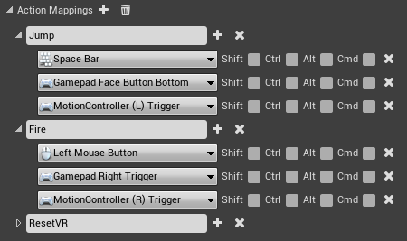
ACTION MAPPINGS
Action mappings are for key and button presses and releases.
The image on the right shows an example of action mappings from the First Person template.
In this example, an action named “Jump” has been created that can be triggered by the space bar, the bottom face button of a gamepad, or the left trigger of a motion controller.

Slide 23
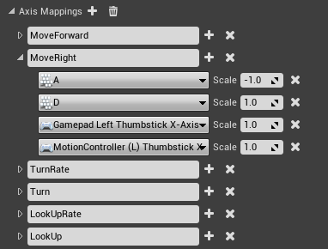
AXIS MAPPINGS
Axis mappings allow for inputs that have a continuous range, such as the movement of a mouse or the analog sticks of a gamepad.
Keys and buttons can also be used in the axis mapping. In the example on the right, the MoveRight action is mapped to the “D” key, with the value of the Scale property set to “1.0”, and to the “A” key, with the value set to “–1.0”, which represents the reverse direction.

Slide 24
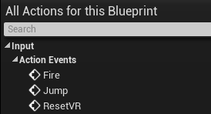
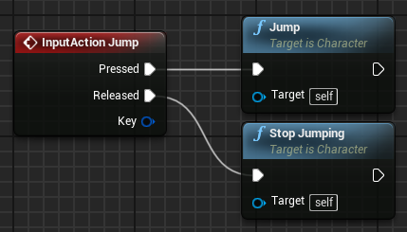
INPUT ACTION EVENTS
All action mappings are available in the Blueprint Editor under Input > Action Events in the context menu.
An InputAction event is generated when the keys or buttons associated with it are pressed or released.
The bottom image on the right shows an example of an InputAction event.

Slide 25
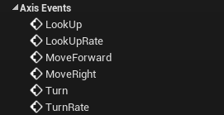
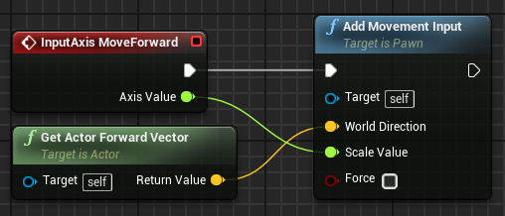
INPUT AXIS EVENTS
All axis mappings are available in the Blueprint Editor under Input > Axis Events in the context menu.
An InputAxis event continuously reports the current value of the axis.
The bottom image on the right shows an example of an InputAxis event.

Slide 26
SUMMARY
This lecture presented components and the Construction Script and showed how to add various types of events to a Blueprint.
It also explained how to manage Actor instances and how to do input mappings.

Slide 27
LABWORK #3:
An Endless Runner (Prototype A)
Objective: Make a platform blueprint which will spawn a new platform at the end of it when the player reaches its center.
Rules:
When player reaches the collision box in the center of the platform spawn a new platform at the tip of current platform.
New platform’s length will be random(integer) : between (5m-15m)
New platform’s rotation(Yaw only) will be in range relative (-45,45) and multiple of 15 degree slices = [-45,-30,-15,0,15,30,45].
Using:
Box Collision Component
ActorBeginOverlap Event
DoOnce
SetRelativeScale3D
SpawnActorFromClass
AddRelativeLocation
GetActorLocation
GetActorForwardVector
RandomIntegerInRange
int * float
Vector * float

Slide 28
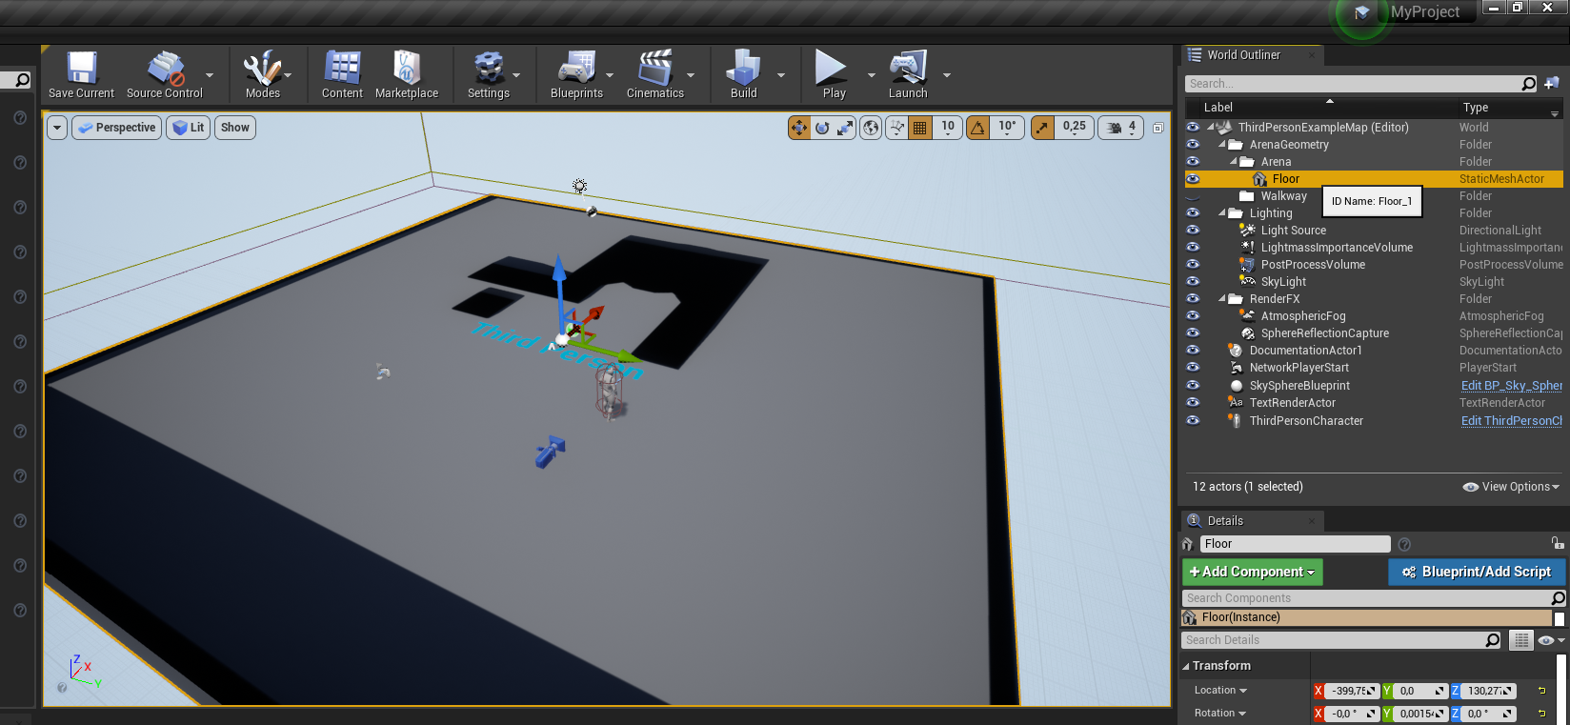
Create a new game project with Thirdperson Template.
Delete all static meshes except “Floor” in ThirdPersonExampleMap.

Slide 29
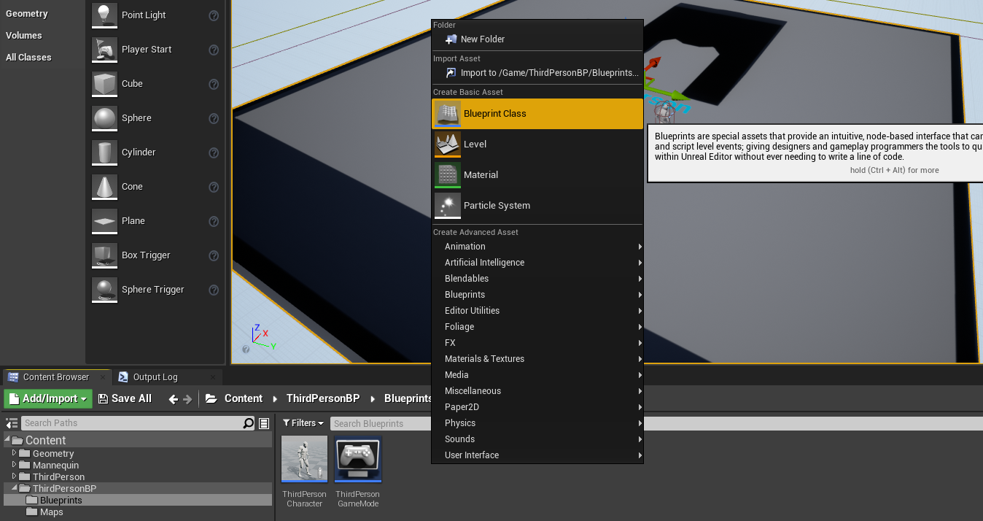
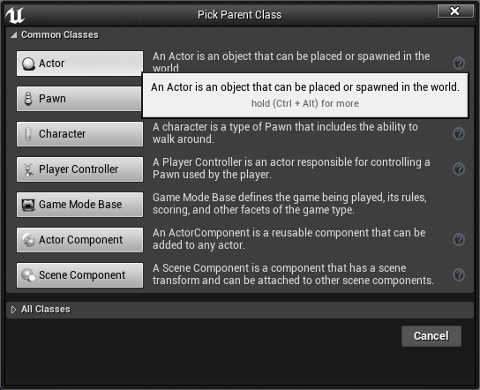
Create a new Blueprint Class named “BP_Platform” under ThirdpersonBP/Blueprints folder.
Pick “Actor” as the parent class.

Slide 30
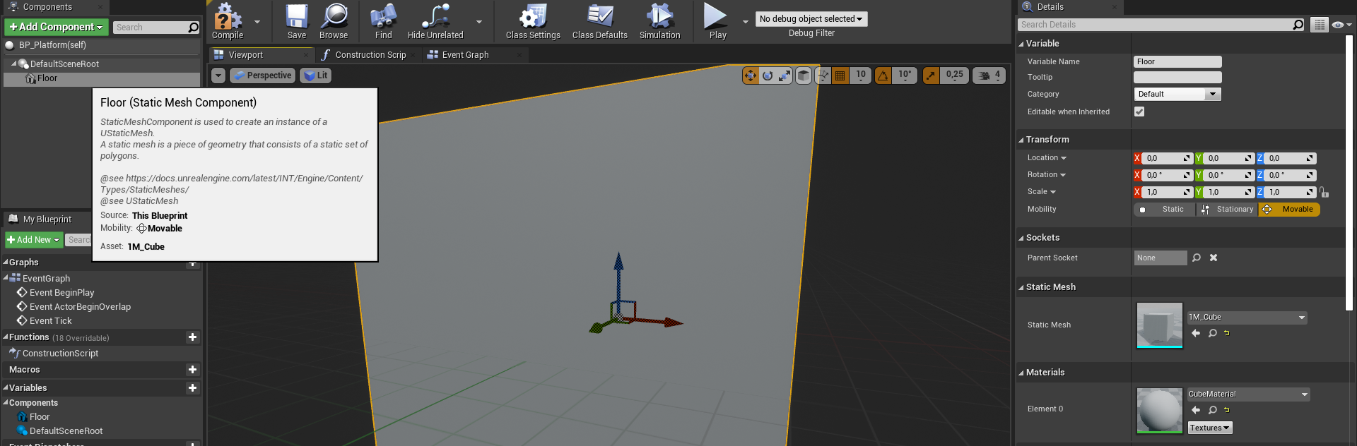
Double click BP_Platform and bring up Blueprint editor and switch to Viewport panel.
Click on “Add Component” on Components panel.
Select StaticMesh.
Name the static mesh component to “Floor”
On the details panel of “Floor” set Static Mesh property from the dropdown assets menu as “1M_Cube”.

Slide 31
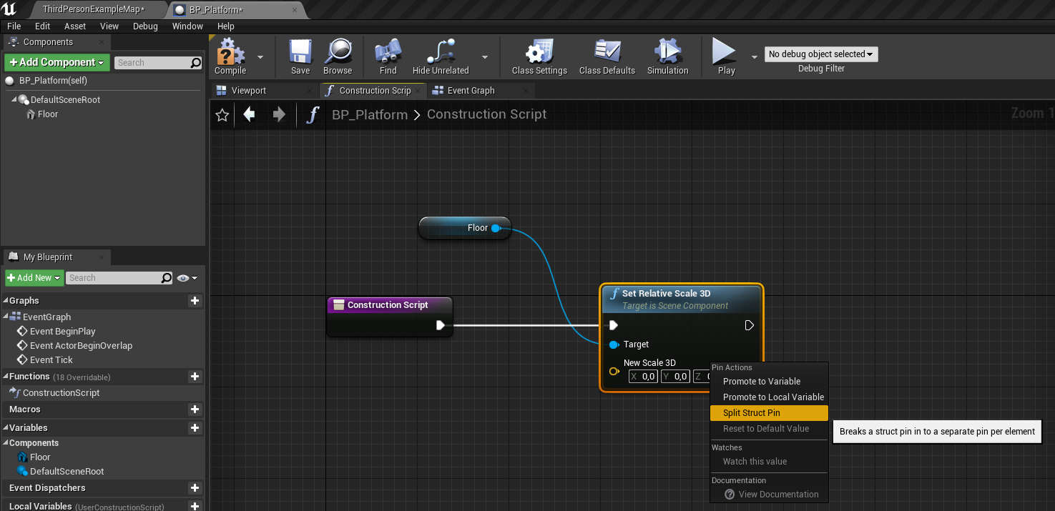
Double click on Functions => Construction Script and bring the script into view.
Drag-drop a reference to Floor and generate a “SetRelativeScale3D” node from it.
Right click on New Scale 3D vector property and select “Split Struct Pin” to split the vector value to X,Y,Z float components.

Slide 32
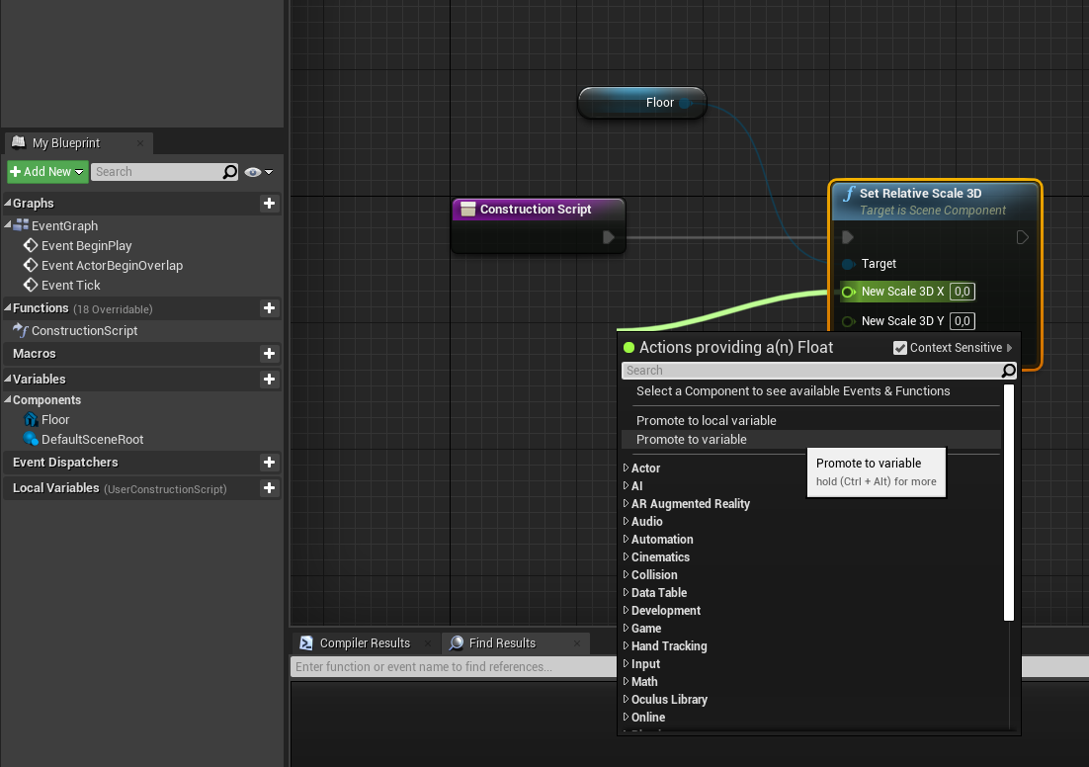
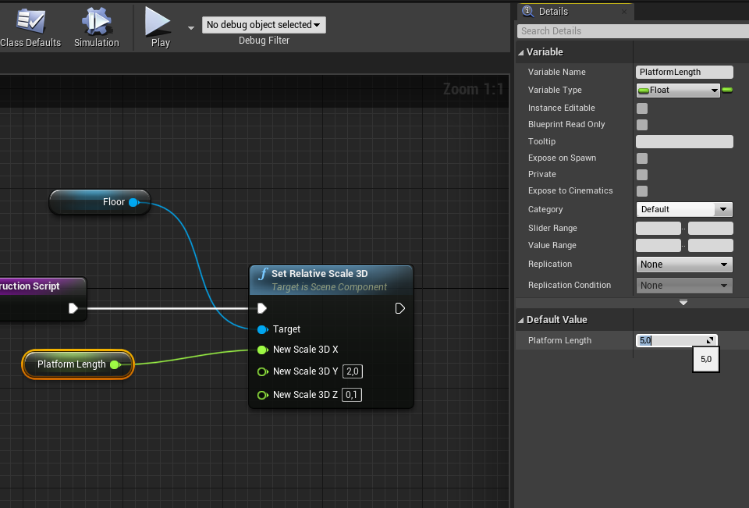
Drag the Scale 3D X pin out and select “Promote to variable”
Enter PlatformLength as the float variable name.
Enter 2.0 to Scale 3D Y, 0.1 to Scale 3D Z !!!
Hit Compile and Set the Default value of PlatformLength to 5.0

Slide 33
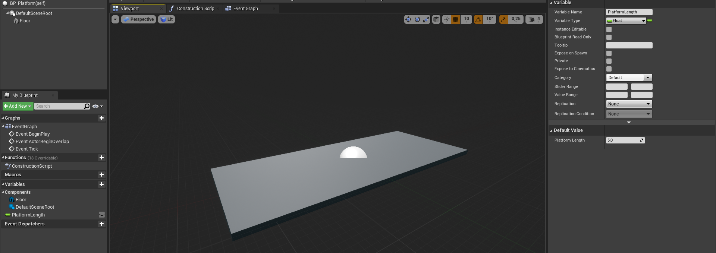
Hit Compile and go to Viewport.
Your platform floor should like this. (500cm x 200cm x 10cm)

Slide 34
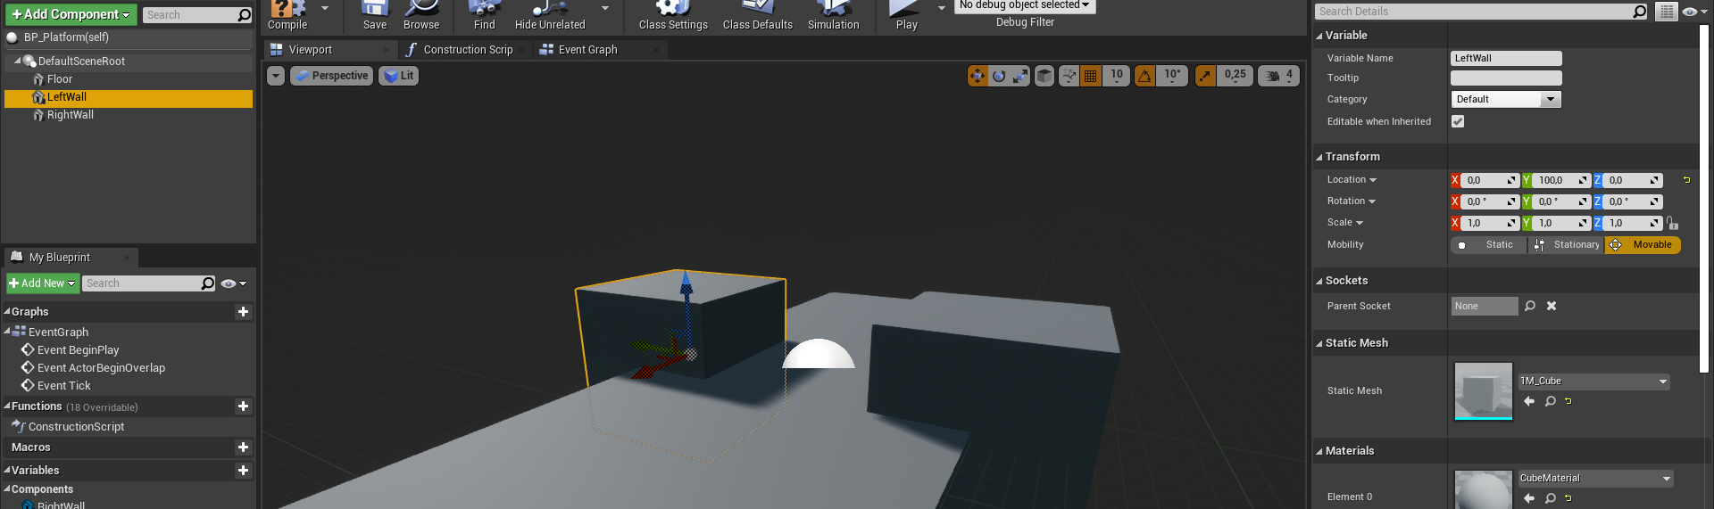
Go back to Components Panel and add 2 more Static Meshes to the DefaultSceneRoot (Click on Add Component button while “DefaultSceneRoot” is selected)
Name one to “LeftWall”, the other to “RightWall”. These will be our barriers to keep player falling from the platform. For a safe trip!
Again, set Static Mesh values of both walls to “1M_Cube”

Slide 35
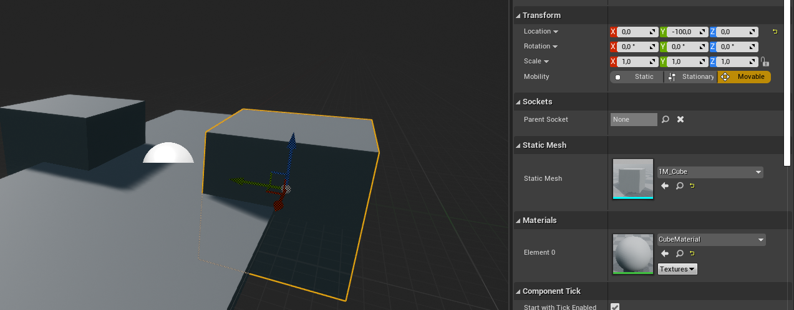
Now position LeftWall at Location (0,-100,0) and RightWall at Location (0,100,0)

Slide 36
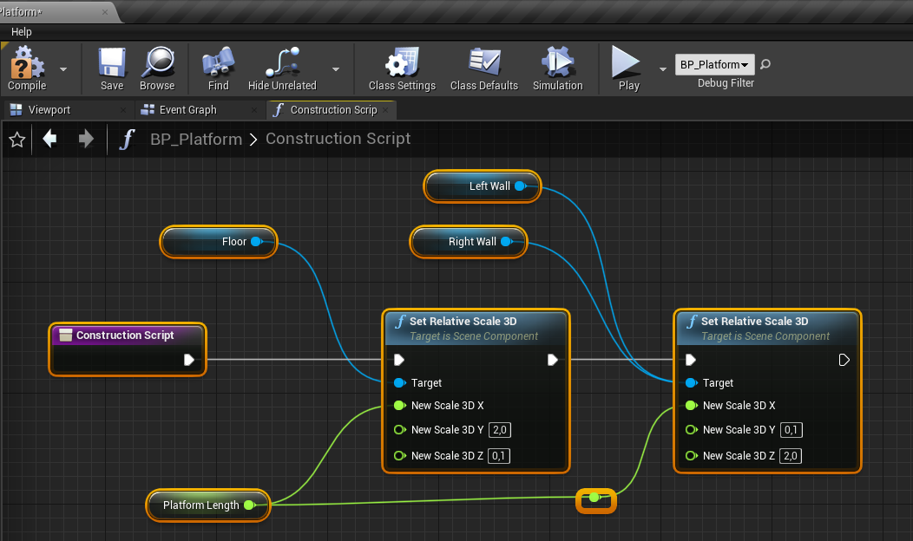
Again, open-up Construction Script and Get one reference per each wall.
Connect both wall’s references to Target pin. So both will perform with the same node...COOL!
Add another SetRelativeScale3D node, plug PlatformLength to X.
Enter 0.1 to Y and 2.0 to Z. Then hit Compile.

Slide 37
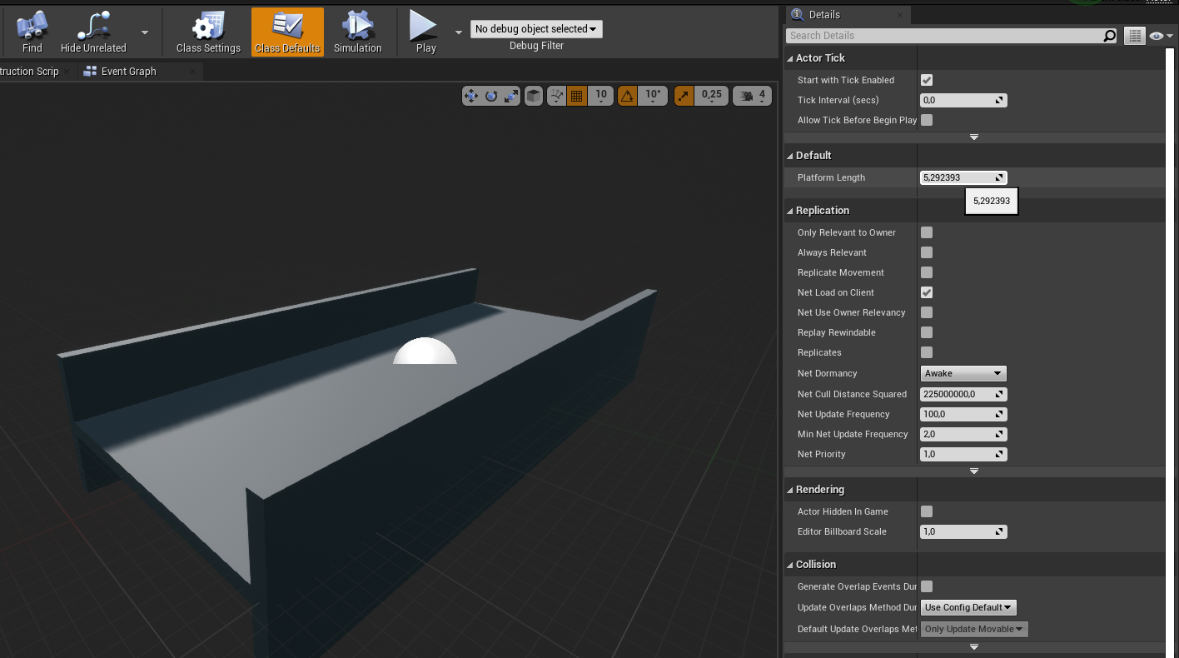
Go back to Viewport, Select “Class Defaults” on the top toolbar.
And play (drag over the input box) with PlatformLength value.
You platform should change length immediately.
Save and Compile!

Slide 38
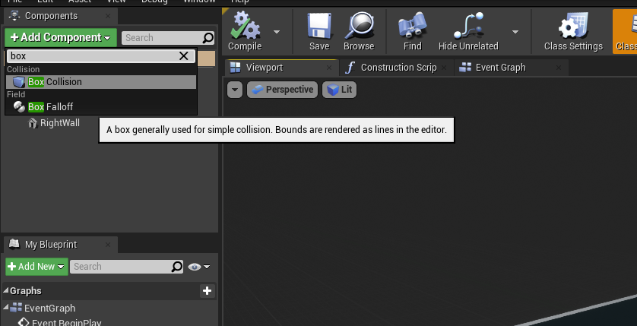
Go back to Viewport, this time let’s add a Box Collision to spawn the next platform.
Hit Add Component while DEfault Scene Root is selected.
Select “Box Collision”!
Name it to SpawnArea.

Slide 39
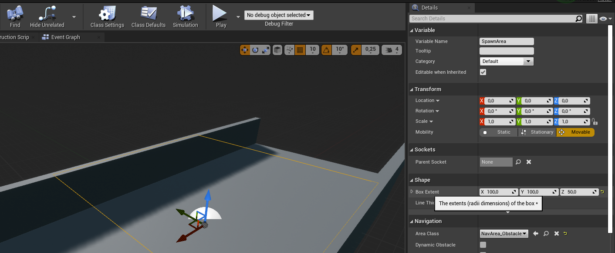
Go to details panel and set Shape => Box Extent to (100,100,50). This will make the collision area cover the platform width.
Compile & Save!

Slide 40
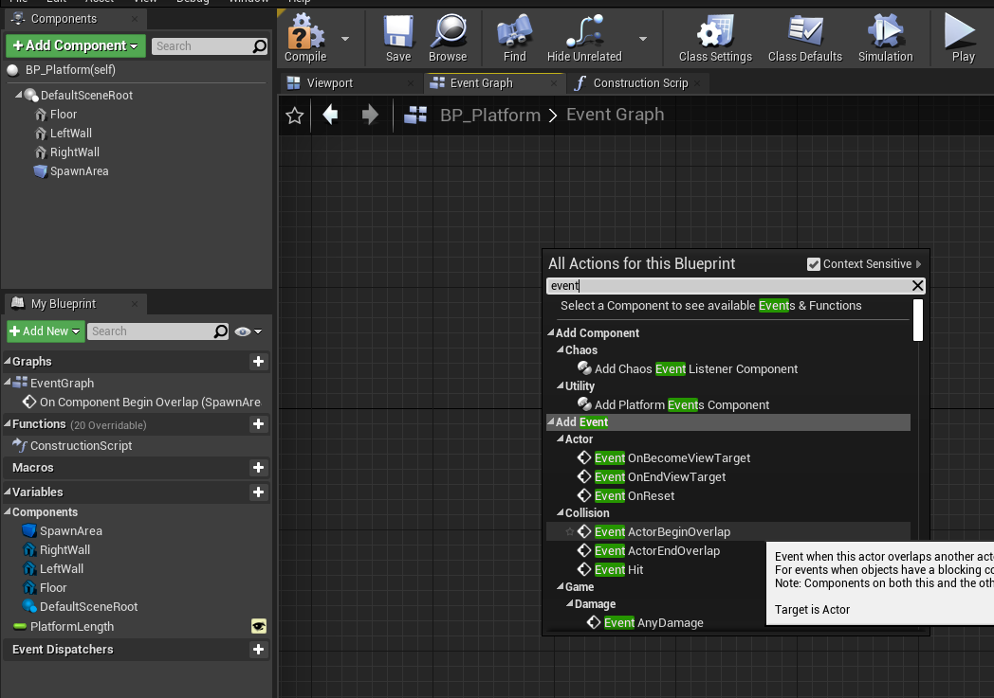
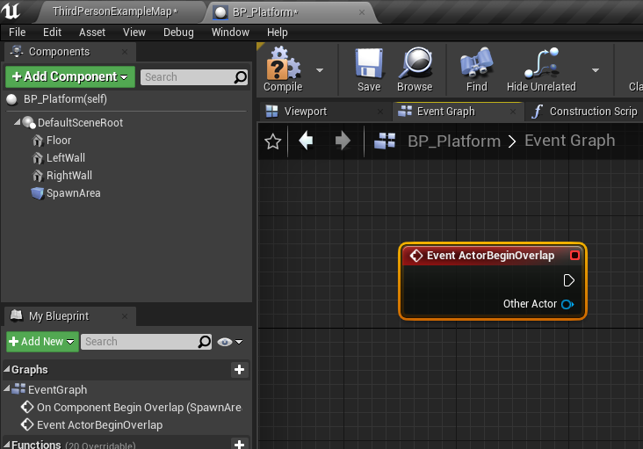
Goto EventGraph, right click and select “Add Event OnActorBeginOverlap”

Slide 41
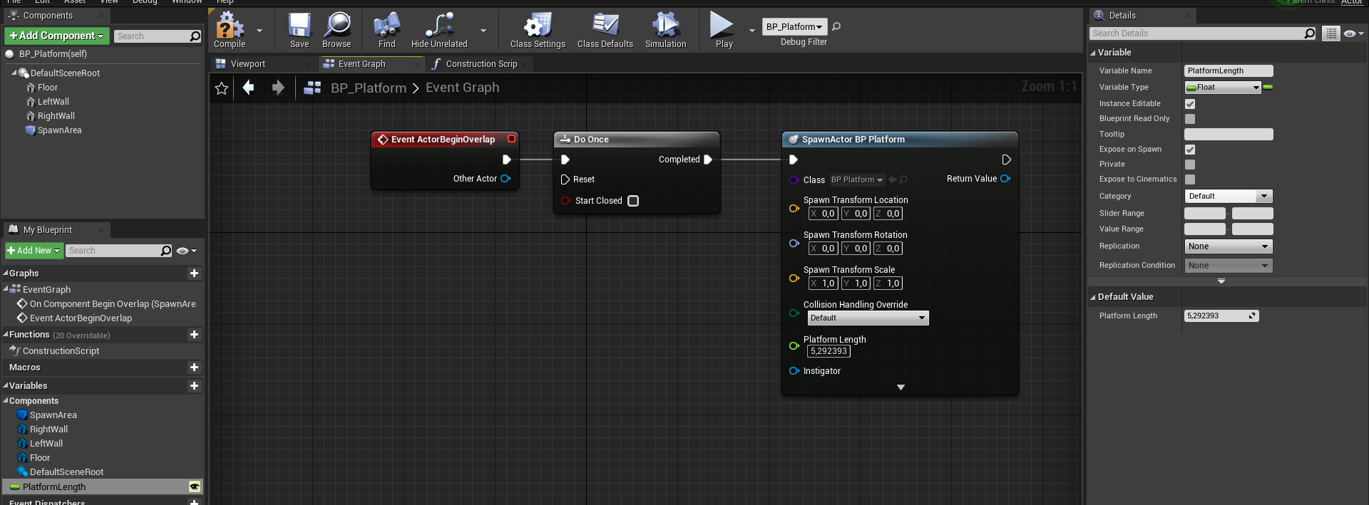
Add a DoOnce node and a SpawnActorFromClass node.
Pick “BP_Platform” as the Class pin on this node.
Go to MyBlueprint panel and select “PlatformLength variable.
On the details panel enable “Instance Editable” and “Expose On Spawn” property.
Hit compile and PlatformLength pin should appear on SpawnActor BP_Platform node.

Slide 42
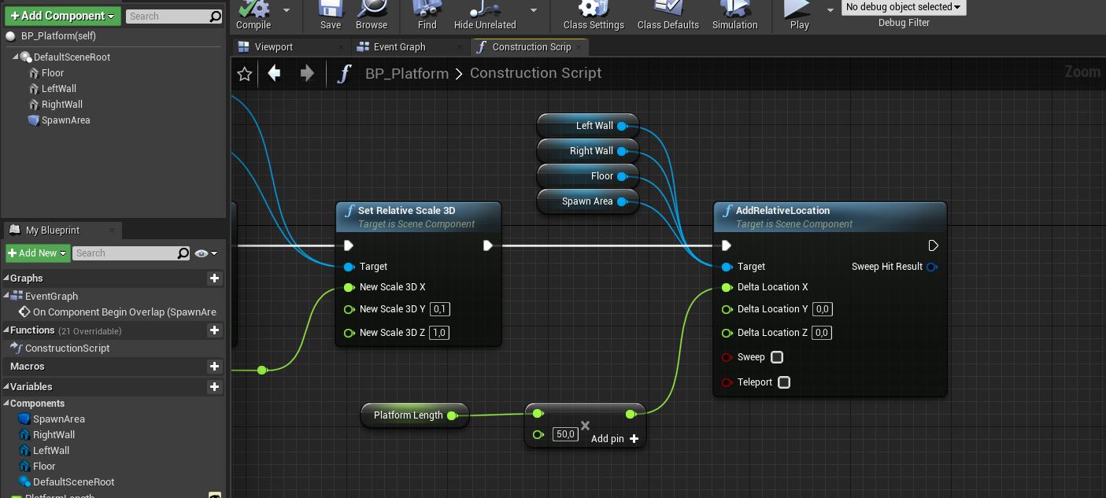
To spawn a new platform at the tip of each, we need to shift the whole object’s pivot to the beginning.
To do this we need to apply a local positioning in X direction.
Go to Construction script again and add this node at the end.
This one add half platform length to every static mesh and the box collision to shift the pivot of the whole blueprint.

Slide 43
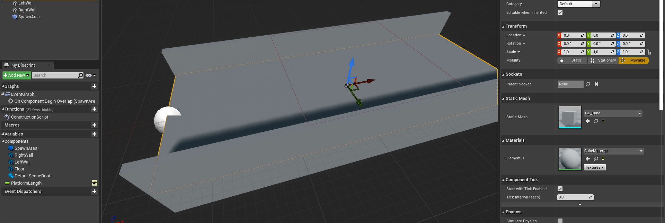
Hit Compile and Save.
This one add half platform length to every static mesh and the box collision to shift the pivot of the whole blueprint.
Notice the DefaultSceneRoot (pivot) no longer is at the center of the platform.

Slide 44
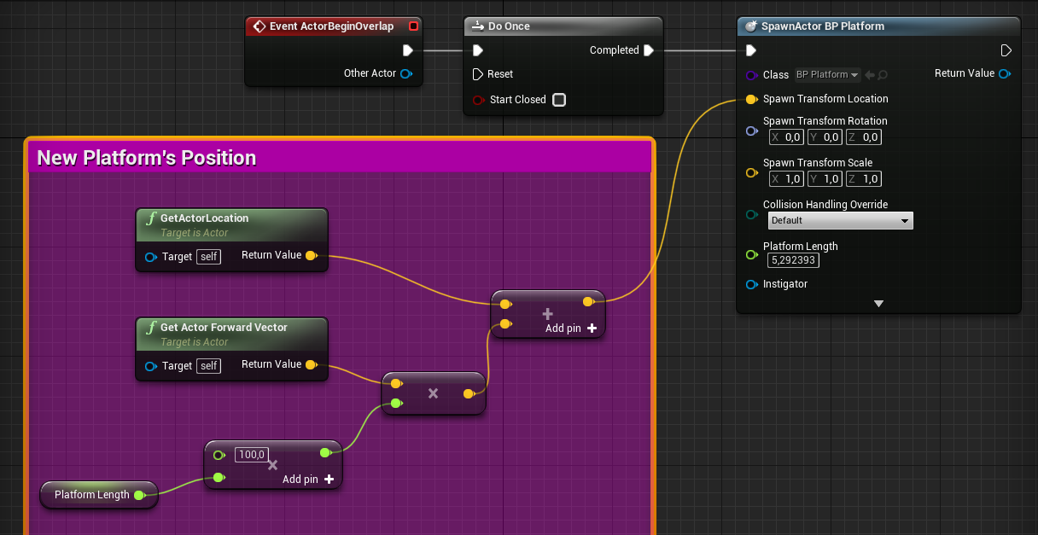
Go back to event graph and compute the location for the new platform.
GetActorForwardVector gives the world direction of X axis alignment of the platform which is the leading direction.
GetActorLocation gives the world coordinates of the current platform’s pivot.
We need to move from the current pivot to the other end of the platform by PlatformLength meters.
Multiple (float * float) to convert into Unreal units(cm) then add (Vector + Vector) the current pivot to get the location of the new platform.

Slide 45
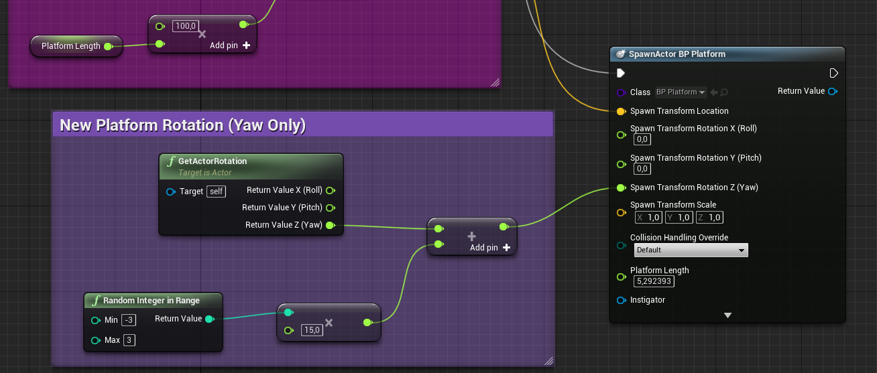
Then calculate the new rotation of the platform.
Since we will only use Yaw axis, split the rotation pin.
GetActorRotation gives the world rotation of the platform. Split the output pin again to the yaw coordinate.
RandomIntegerInRange gives numbers from -3 to 3. Multiple by 15.0 (int * float) to get slices (-45,-30,-15,0,15,30,45)
Add the new rotation to current yaw (float + float)

Slide 46
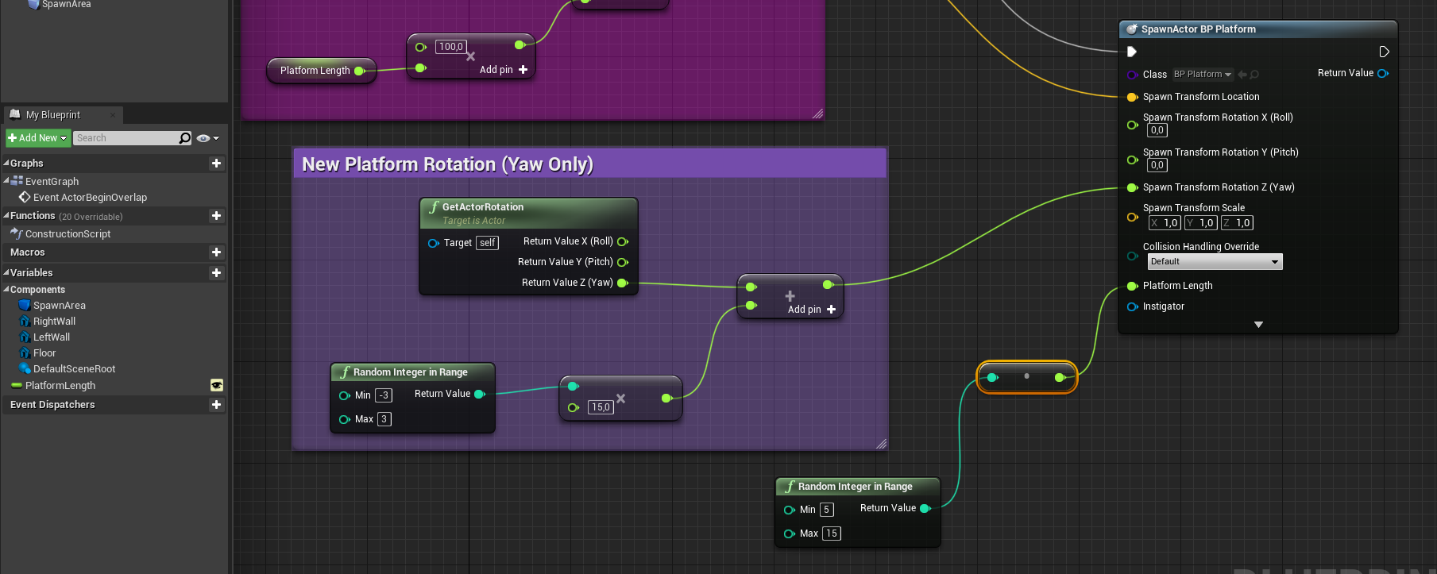
Lastly compute the new random length.
Add RandomIntegerInRange (5,15) and directly plug into PlatformLength pin of the SpawnActor node.

Slide 47
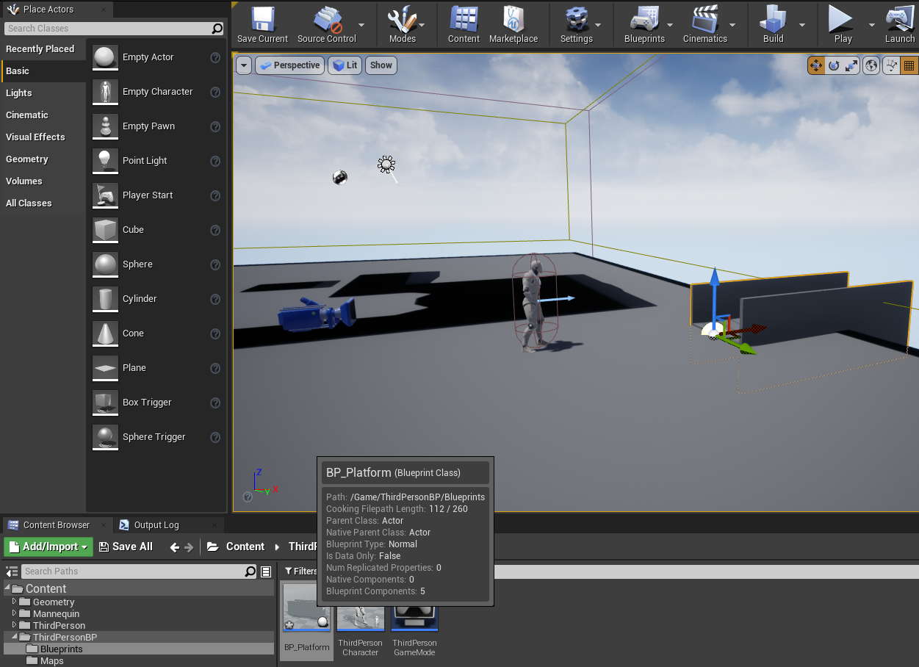
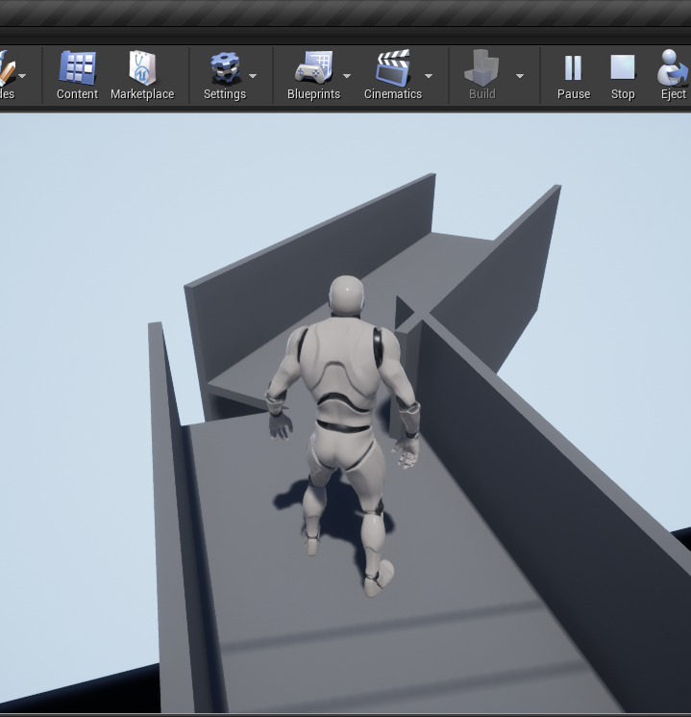
Compile and Save.
Go back to Editor view.
Place a new instance of the BP_Platform at the edge of the floor.
PLAY and Start running!

Slide 48
Phase 2
Try to orient the new platforms with Pitch (Y) axis as well:
Decide the random range of the Pitch angle.
Do something creative by playing PlatformLength and Rotation parameters of the spawned BP_Platforms.

Slide 49
Phase 3: The collectible Gold
Implement a rotating torus mesh with gold material for each BP_Platform.
Position the cold randomly along the platform.
Use OnComponentBeginOverlap event when the player overlaps with the cold and then call DestroyComponent on it.

Slide 50
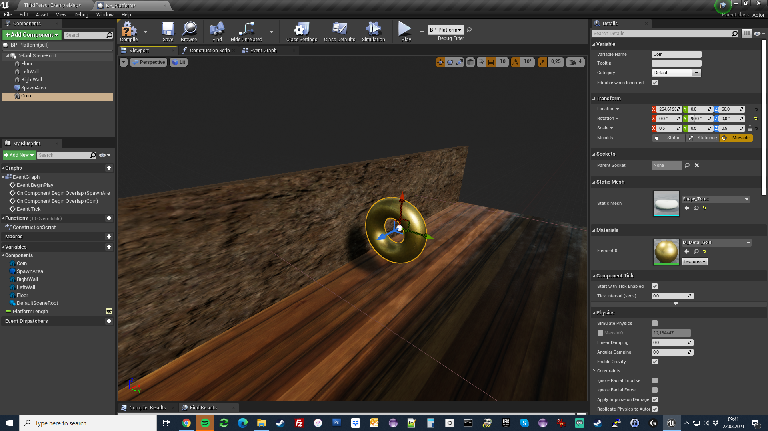
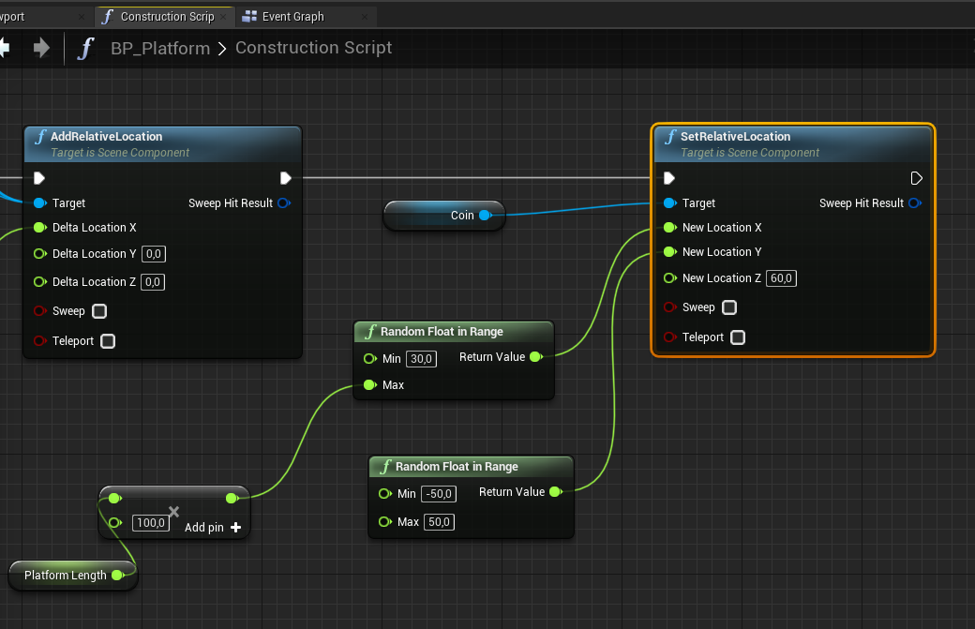
Add Coin static mesh component.
Modify the construction script as below.

Slide 51


Remove ActorBeginOverlap and add OnComponentBeginOverap event for the SpawnArea as follows. This must be done due to a bug in UE4 :( You need to delay the initial collision… Right Click on the Spawn Area => Add Event => Add OnComponentBeginOverlap!
Don’t forget to set Collision Presets of the Coin to “Overlap All” or the player will bump into the coin :\

Slide 52

Then collect and rotate coin code can be implemented as below.
We use Cast To ThirdPersonCharacter to make sure the overlapping actor the player itself! Because new spawned platforms may also overlap. So we want to ignore those overlaps!
AddRelativeRotation node rotates the cold at every game tick for 360 degrees per second.

